Slide 2
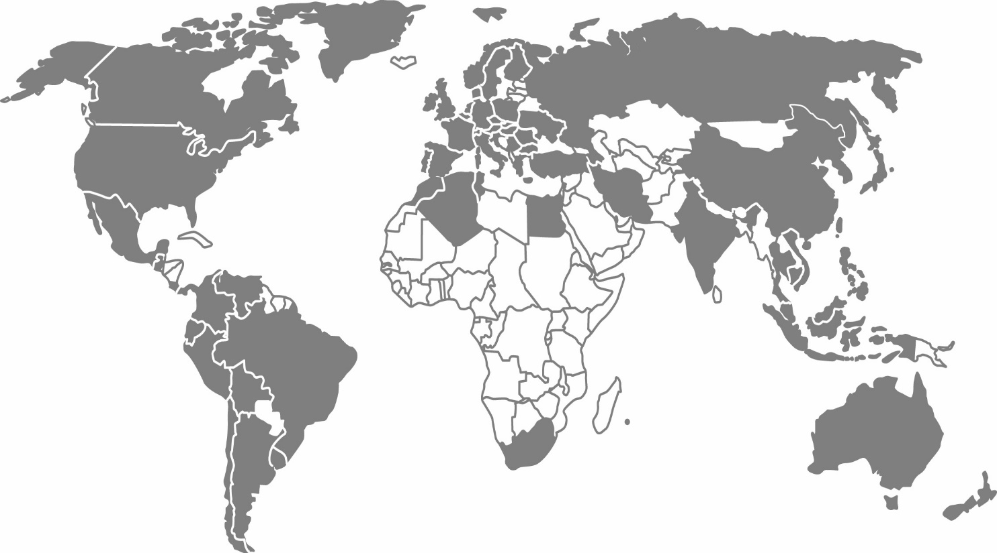
Sika global experience
Founded in 1910 starting with waterproofing of tunnels in Europe
Subsidiaries in 100 countries with sales > $7 billion
Over 17,000 employees with focus on innovation, about 1,000 people in R&D
Leader in concrete expertise and concrete repair & protection products
Still growing with a floor to roof construction product offering

Slide 3
Sika’s target markets
Roofing
Flooring
Concrete Products
Waterproofing
Residential
Repair & Protection
Sealants & Adhesives
Industry/Manufacturing
Automotive/Transportation

Slide 4
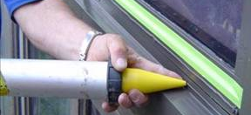
Sealants

Slide 5
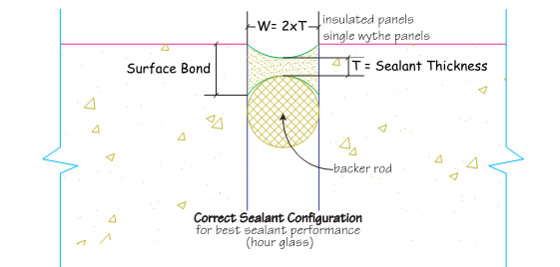
Joint Design and Installation
Match joint size to sealant movement capability - best 4 times anticipated
2:1 width to depth ratio is best
Install backer rod or tape to prevent 3-sided adhesion and control depth
Best to do work when joint at midpoint of movement
Sealant needs to be tooled to force it against the joint walls

Slide 6
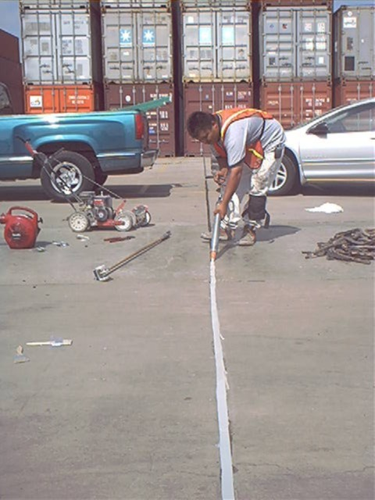
Astm C-920 Sealant specification
Type: S or M
Single or Multi-component
Grade: P or NS
Pourable or Non-Sag
Class: 12.5, 25, 50, 100/50
% of movement
Use: T, NT, I, M, G, A, O
Traffic
Non-traffic
Immersion
Mortar
Glass
Aluminum
Other

Slide 7
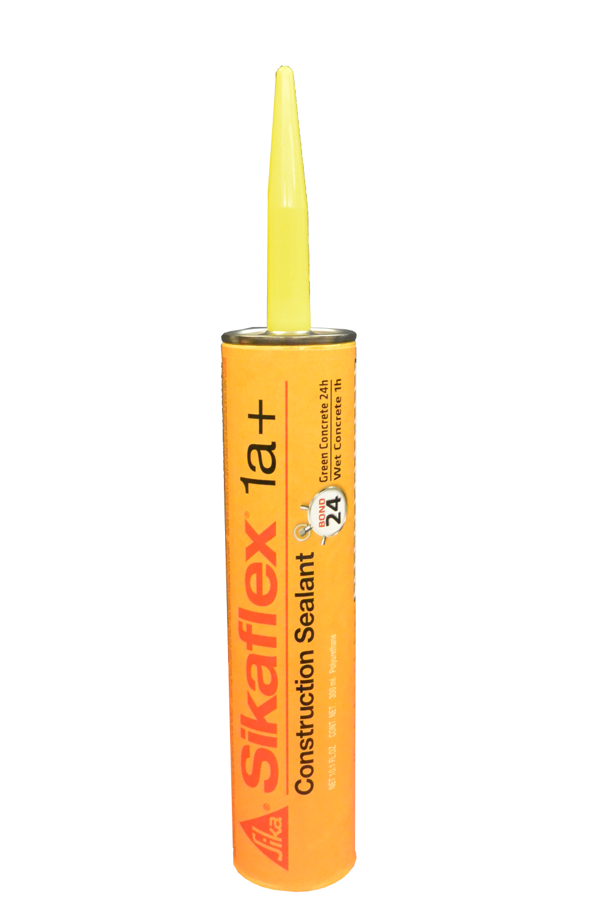
Sikaflex 1a and Sikaflex 1cSL

Slide 8
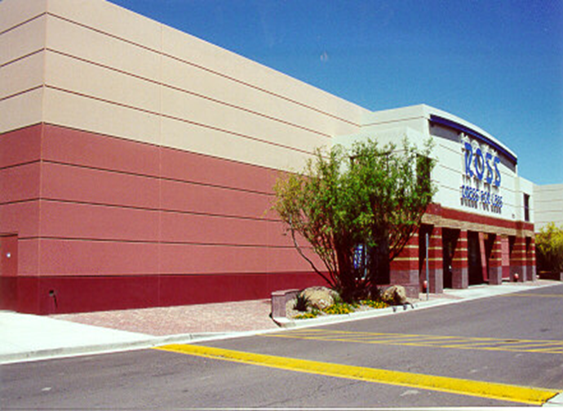
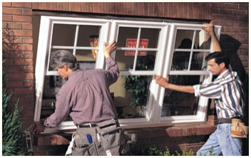
Sikaflex 15 LM and Sika Hybrid 150 LM
Sikaflex 15 LM
Sika Hybrid 150 LM
Vertical
Most movement
EIFS
Hybrid sealant
White stays white
Better bond to vinyl

Slide 9
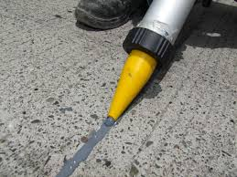
Sikaflex 2c NS/SL
Two component urethane sealants
1.5 gallon and 3 gallon pails

Slide 10
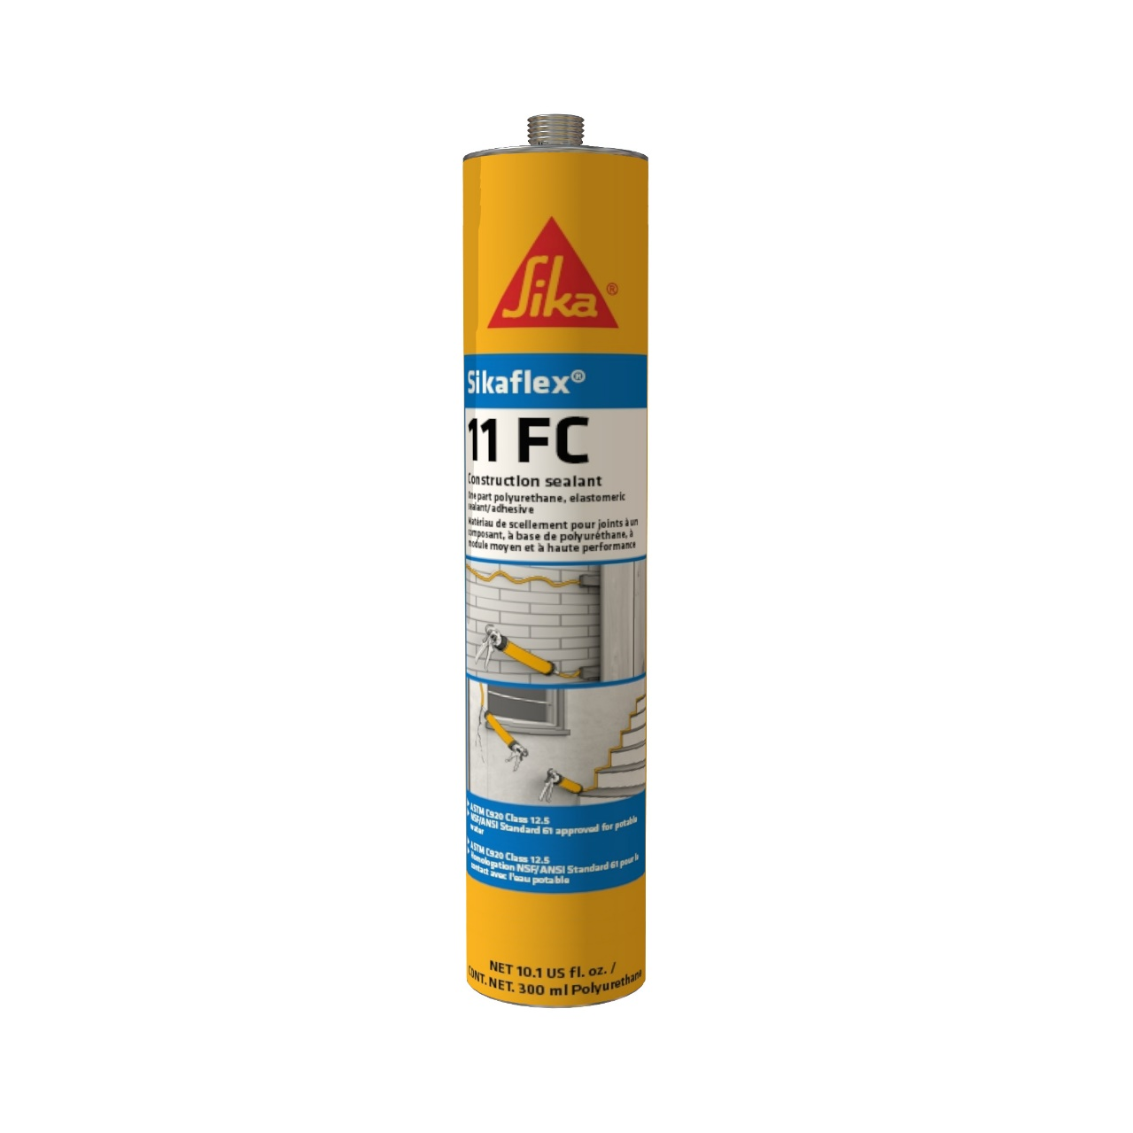
Sikaflex 11 FC
Elastomeric adhesive
Fast cure
Equivalent to Liquid Nails

Slide 11
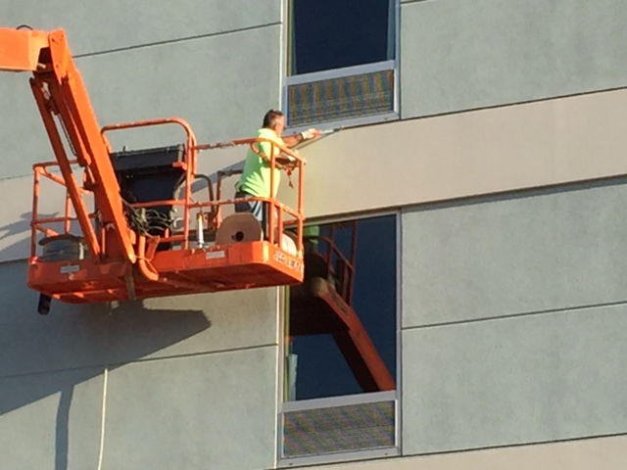
Sikasil 295 and Sikasil 290
Silicone sealants
Bonding to glass
Longest life expectancy
Non Staining
295 equal to Dow 795,756, Pecora 895, 864, Spectrum 2,3, SCS2000, and SCS 9000.

Slide 12
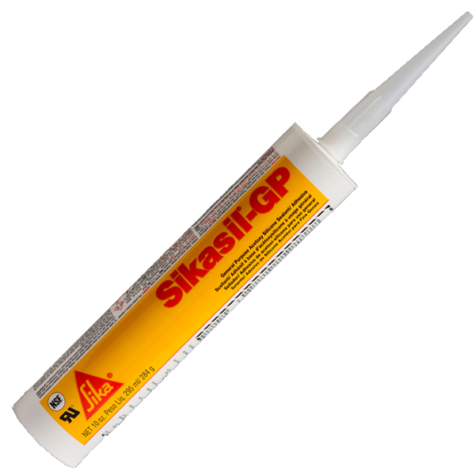
Sikasil GP
Bathrooms
Kitchens

Slide 13
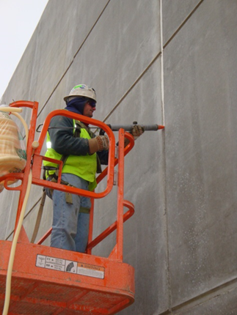
Sealant Innovations
Sikaflex 2c NS Arctic
Two-component, non-sag, polyurethane sealant
Cold temperature mix and apply down to 15F.
For installations when temperatures are between 15F and 50F. For 50F and over use standard EZ Mix formula.

Slide 14
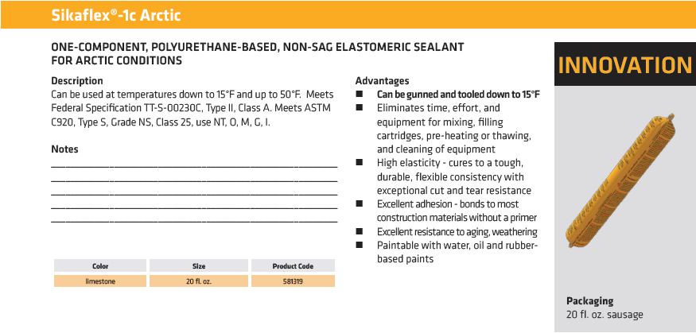
SEALANTS

Slide 15
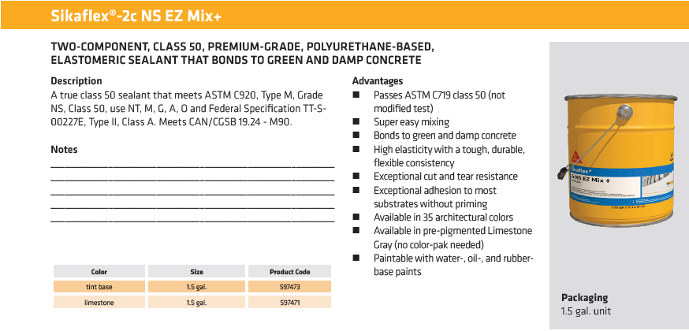
SEALANTS

Slide 16
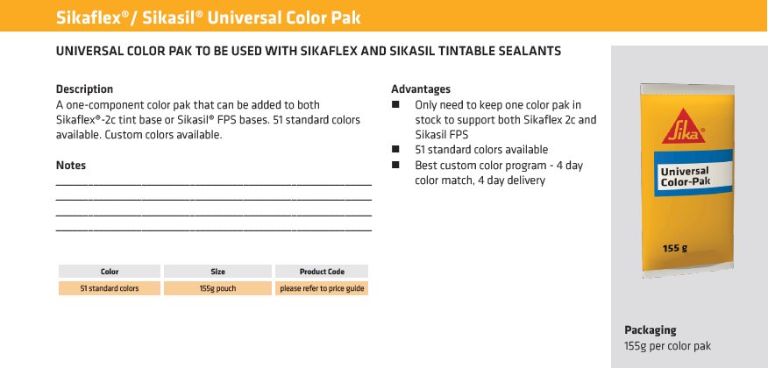
SEALANTS

Slide 17
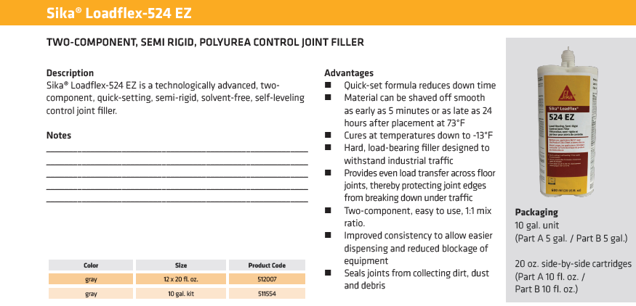
SEALANTS

Slide 18
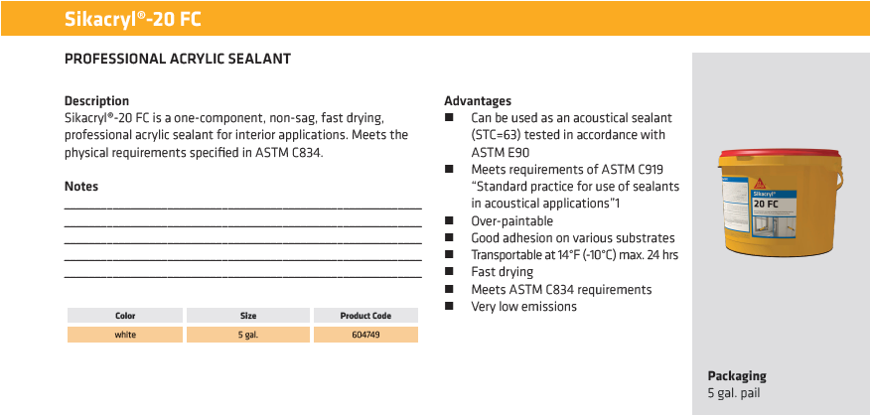
SEALANTS

