Slide 1
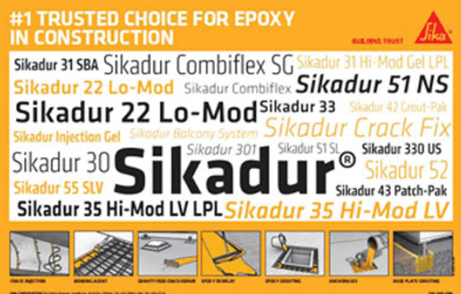
Epoxies

Slide 2
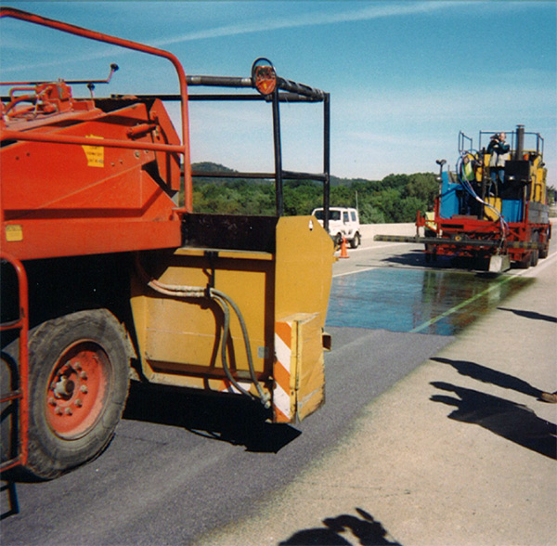
Epoxies and Their Applications
Crack Repair
  Rout and fill
  Epoxy Injection
  Flood and fill
Bonding Agent
Spall Repair
Broadcast Overlay
Anchoring

Slide 3
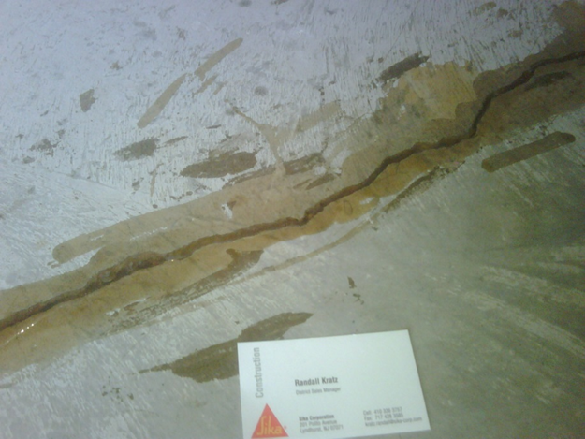
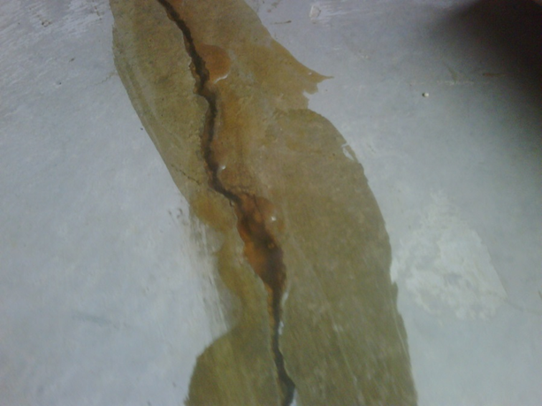
Rout and Fill with Epoxy
Bonded, rigid repair, eliminating the crack
Extremely durable and long lasting
Use a High Modulus, low viscosity material
Sikadur 35, 52, or 55

Slide 4
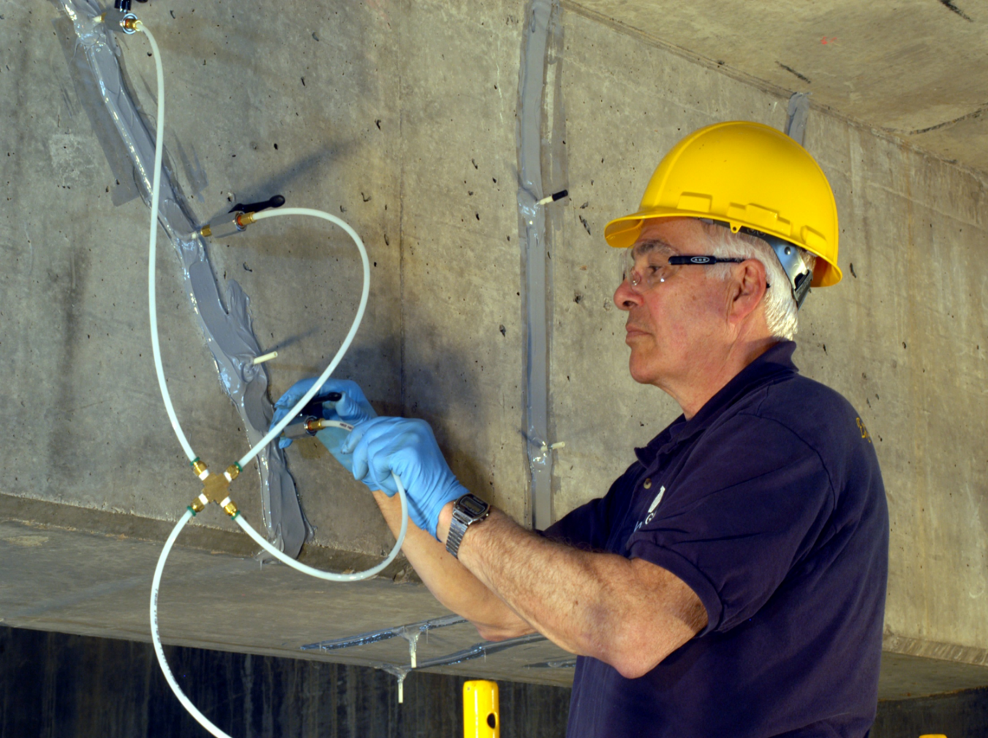
Epoxy Injection
Capseal material
Sikadur 31
Sikadur AnchorFix 1, 2, 500, or 3001
Injection Resin
Sikadur 35 Hi-Mod LV
Sikadur 52 Hi-Mod
Sikadur 55 SLV
Sikadur Crack Fix

Slide 5
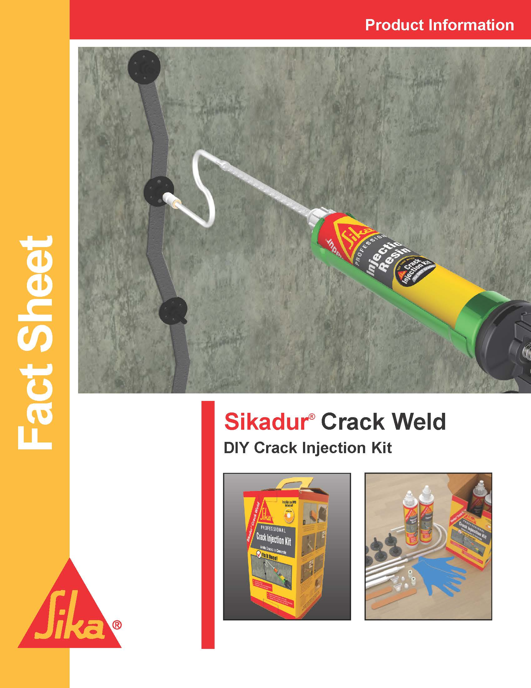
Sikadur Crack Weld
All in one box convenience
Just need a standard caulk gun

Slide 6
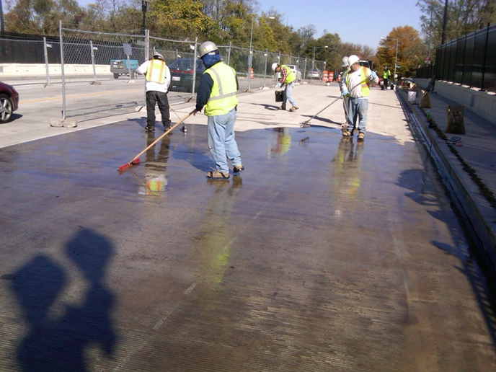
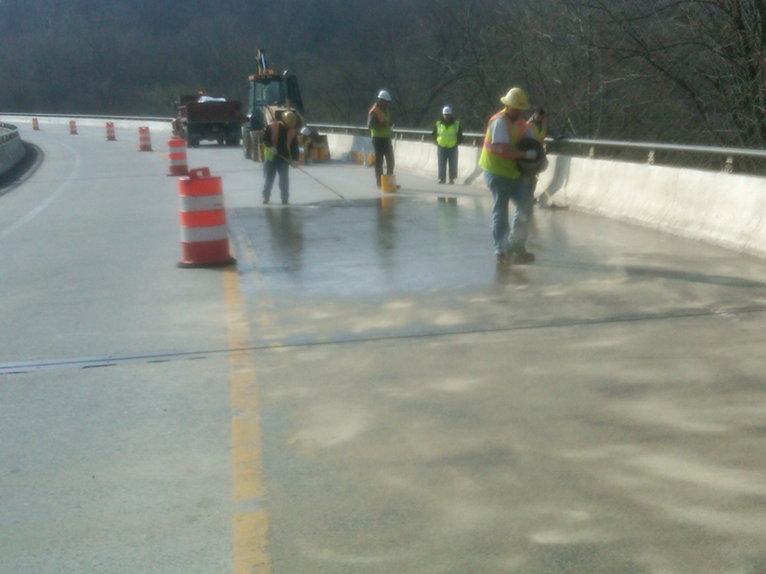
Flood and Fill with Epoxy
Allow super low viscosity resin to pond
Broadcast sand for slip resistance
Fast traffic time
Sikadur 55 SLV is most commonly used
Sika Pronto 19 TF also, new 2019 product Sika Pronto 19 3K

Slide 7
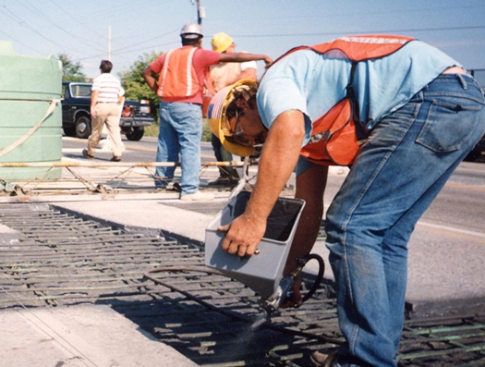
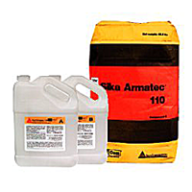
Reinforcement Coating and Bonding Agent
Improve the bond strength
Reduces future corrosion of rebar
Sikadur 32 Hi-Mod
Epoxy
Best overall bond strength
Sika Armatec 110 EpoCem
Not a vapor barrier
Not a bond breaker

Slide 8
Epoxy Innovations
Sika Armatec 1c
Single component version of 110
Sika Armatec 10 ZR
Zinc rich rebar coating

Slide 9
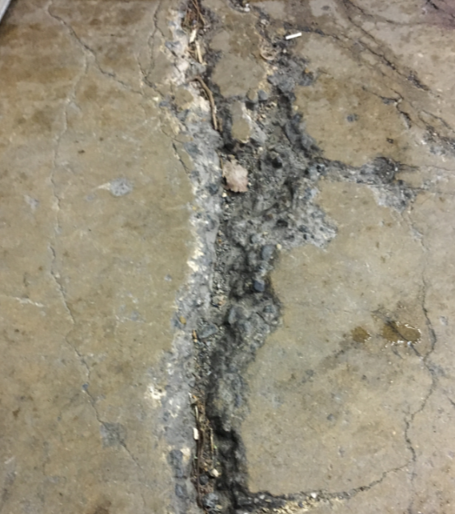
Spall Repair
Epoxies can be used to repair spalls in concrete
Reduces surface prep
Mix with aggregate to make epoxy mortar
Max depth ½”

Slide 10
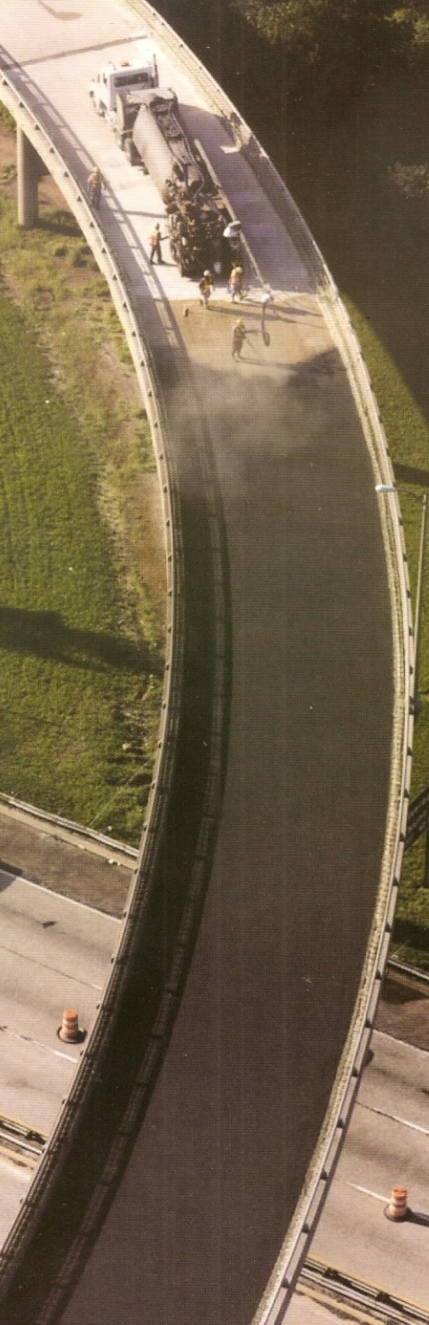
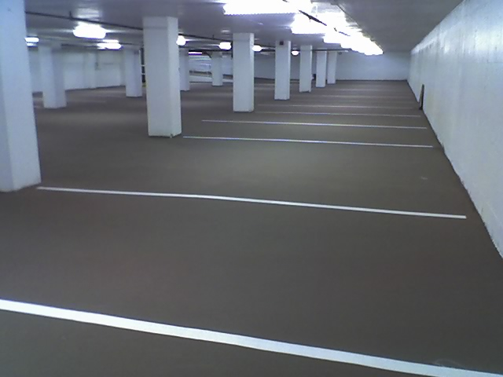
Epoxy Overlay
Sikadur 22 Lo-Mod
Durable
Fast
Impervious
Economical
Attractive
Proven

Slide 11
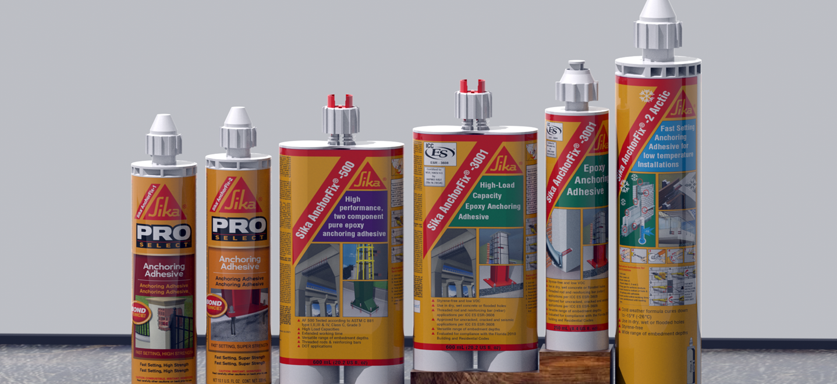
Chemical Anchors
Sika AnchorFix 1
Sika AnchorFix 2
Sika AnchorFix 500
Sika AnchorFix 3001

Slide 12
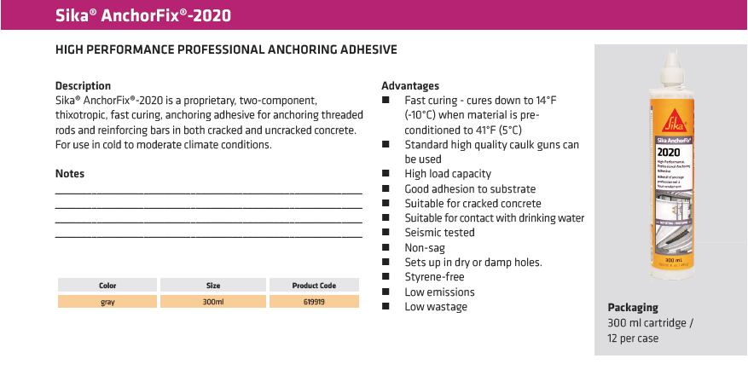
anchoring

